Slide 1
Boosting Algorithm
Kaaviya Saraboji

Slide 2
Boosting in Machine Learning
Boosting is a process that uses a set of Machine Learning algorithms to combine weak learner to form strong learners in order to increase the accuracy of the model.
The boosting algorithms are primarily used in machine learning for reducing bias and variance.
It is done by training a model using training data and is then evaluated. Next model is built on that which tries to correct the errors present in the first model.
This procedure is continued and models are added until either the complete training data set is predicted correctly or predefined number of iterations is reached.

Slide 3
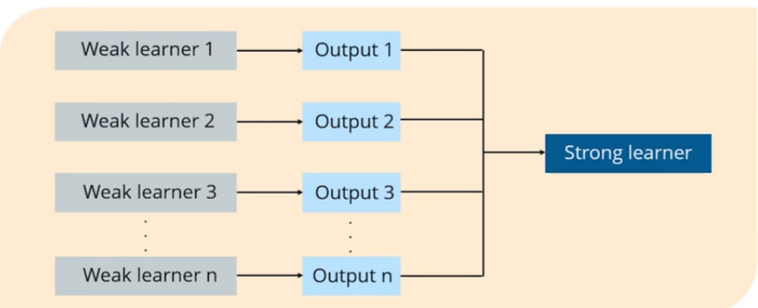
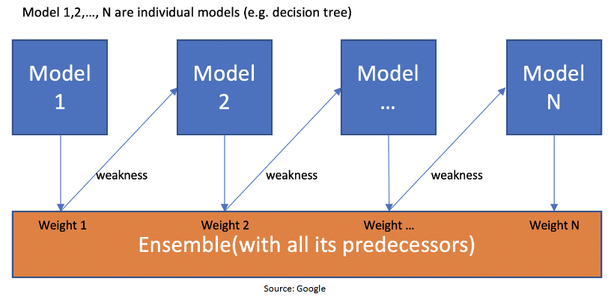

Slide 4
Boosting Algorithms - Regression
Ada Boosting (Adaptive Boosting)
Gradient Boosting
Hist Gradient Boosting

Slide 5
AdaBoostRegressor
An AdaBoost regressor is a meta-estimator that begins by fitting a regressor on the original dataset and then fits additional copies of the regressor on the same dataset but where the weights of instances are adjusted according to the error of the current prediction. As such, subsequent regressors focus more on difficult cases.
One way for a new predictor to correct its predecessor is to pay a bit more attention to the training instances that the predecessor has incorrectly classified. This results in new predictors focusing more and more on the hard cases. This is the technique used by Ada‐Boost.

Slide 6
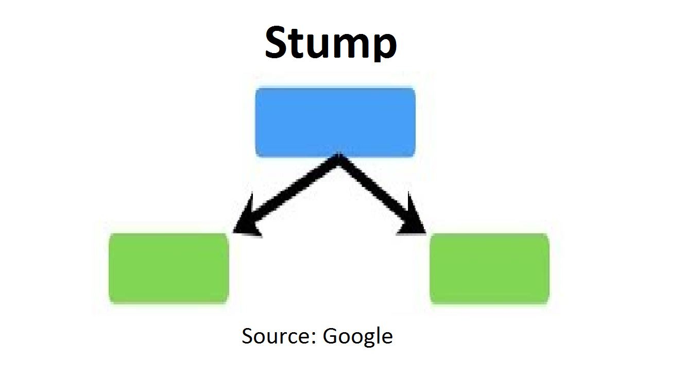
AdaBoostRegressor
Example: When the random forest is used, the algorithm makes n number of trees. It makes proper trees that consist of a start node with several leaves nodes. Some trees might be bigger than others, but there is no fixed depth in a random forest. But with Adaboost, that’s not the case. In AdaBoost, the algorithm only makes a node with two leaves, and this is known as Stump.
Note – The figure shown above represents the stump. It can be seen clearly that it has only one node with only two leaves. These stumps are weak learners, and boosting techniques prefer this. The order of stumps is very important in AdaBoost. The error of the first stump influences how the other stump is made.

Slide 7
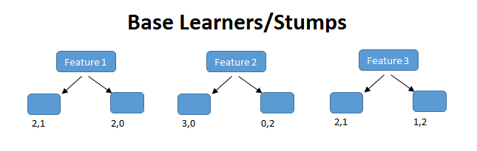
AdaBoostRegressor
Step 1:
At very first step Ada Boost reads the dataset and assigns equal weight to each feature.
Initially, all the samples will have the same weight : W=1/N
Step 2:
In this step Ada boost will create it’s first base learner i.e. the first stump. It will create the same number of stumps as the number of features.

Slide 8

AdaBoostRegressor
Step 3:
Now, Ada boost will calculate the total error by using the formula :
No. of Samples classified as wrong / Total No. of Samples
Step 4:
After calculating the total error now Ada boost will calculate the performance of stump.

Slide 9
AdaBoostRegressor
Step 5 :
Now, Ada boost will update the weights of correctly and in correctly classified samples.
Step 6:
Now, in this last step the Ada boost will create a new dataset for the next weak learner
The algorithm will run 5 iterations to select different-different records from the older dataset. In each iteration the algorithm will take one random value and selects the record whose bucket contains that value. Like this there is a high probability for the wrong records to get selected several times.

Slide 10
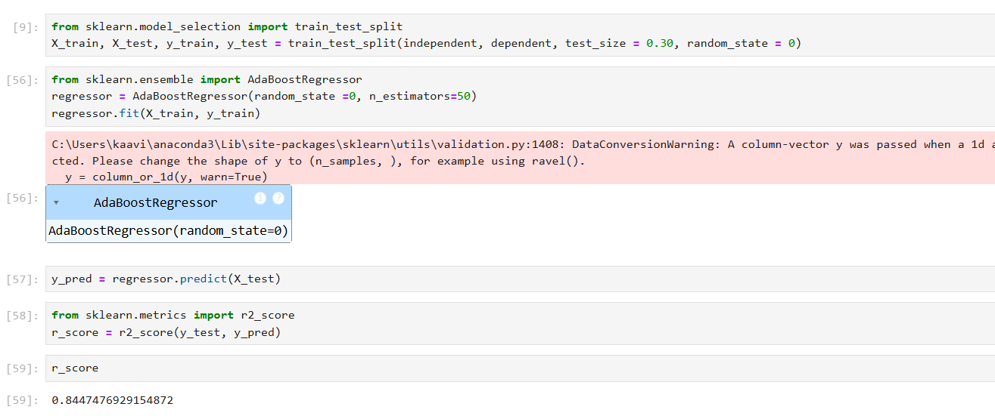
AdaBoostRegressor
Example: AdaBoostRegressor – Insurance Charges Prediction

Slide 11
GradientBoostingRegressor
Just like Ada Boost, Gradient Boosting works by sequentially adding predictors to an ensemble, each one correcting its predecessor. However, instead of tweaking the instance weights at every iteration like Ada Boost does, this method tries to fit the new predictor to the residual errors made by the previous predictor.
This estimator allows for the optimization of arbitrary differentiable loss functions. In each stage a regression tree is fit on the negative gradient of the given loss function.
The base learners are generated sequentially in such a way that the present base learner is always more effective than the previous one.
It can be used for both classification and regression problems.

Slide 12
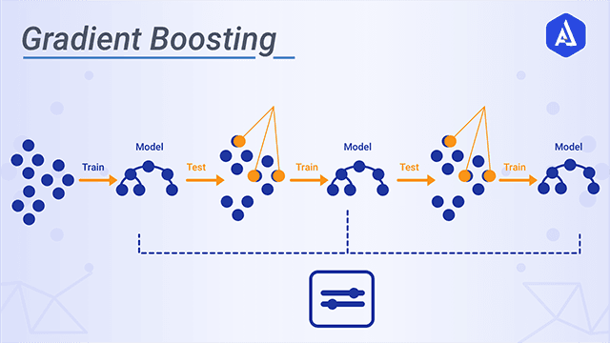
GradientBoostingRegressor
Normally there are three main steps involved for performing Gradient Boost:
Loss Function that needs to be ameliorated.
Weak Learner for computing predictions and forming strong learners.
An Additive Model that will regularize the loss function

Slide 13
GradientBoostingRegressor
Step 1:
Gradient Boost starts by making a single leaf, instead of a tree or stump. This leaf represents a initial guess for the weights of all the samples.
Usually while trying to predict a continuous value the first guess is the average value.
In, regression we can easily calculate the average of all the values but in classification we do this by taking log of odds.
And, for using these log of odds we will be converting these log of odds to probability by using Logistic Function.
Step 2:
Then, Gradient boost tries to calculate the residuals by subtracting the predicted value by the actual value of the dependent variable.
One thing to remember is that sometimes we call these residuals as pseudo residuals. The term pseudo residual is based on linear regression where the difference between observed and predicted values results in residuals. The “pseudo” part of pseudo residual is a reminder that we are doing Gradient Boost and not linear regression.

Slide 14
GradientBoostingRegressor
Step 3:
Now, Gradient Boost will construct a decision tree using the input features and these residuals.
It will try to fit all of these features according to the output of first residuals.
And, when it passes these input features again to this decision tree it will be getting a new set of residuals by using the same formula i.e. Observed value – Predicted Value.
Note : Gradient Boost has a tendency to overfit the dataset. So, to solve this we normally multiply the residual with the learning rate α (alpha) and the add it to the previous model’s output value.
Step 4:
Now, Gradient Boost will be creating another decision tree with the output of the second residuals and they will be giving another set of residuals. Like this it will be building more and more decision tress and the process goes on and on.

Slide 15
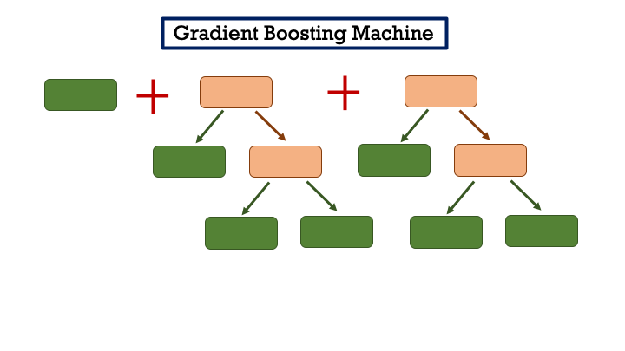
GradientBoostingRegressor
At this stage the residuals will keep on decreasing as more and more decision trees are made. And our main aim is to basically reduce this residual error to some extent.
At last the addition of the outputs of all the sequential decision tree happens and that will be the final output of Gradient Boosting Algorithm.
F(x) = h₀(x) + α₁h₁(x) + α₂h₂(x) + . . . . . + α_{n}h_{n}(x)

Slide 16
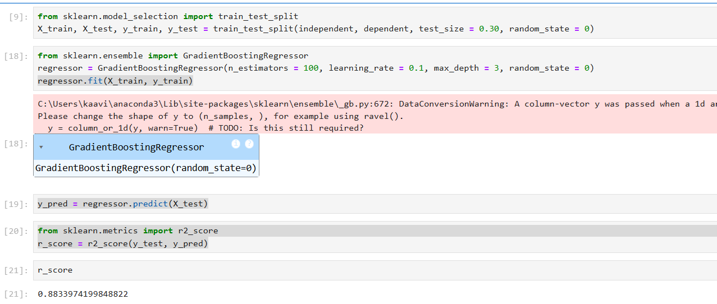
GradientBoostingRegressor
Example: GradientBoostingRegressor – Insurance Charges Prediction

Slide 17
HistGradientBoostingRegressor
This estimator is much faster than GradientBoostingRegressor for big datasets.
This estimator has native support for missing values (NaNs). During training, the tree grower learns at each split point whether samples with missing values should go to the left or right child, based on the potential gain. When predicting, samples with missing values are assigned to the left or right child consequently. If no missing values were encountered for a given feature during training, then samples with missing values are mapped to whichever child has the most samples.
HistGBM, short for Histogram-based Gradient Boosting, employs histogram binning to accelerate tree construction while maintaining predictive accuracy. By grouping continuous feature values into discrete bins, it reduces memory consumption and speeds up computations during the splitting phase of tree construction.
HistGBM is designed for efficiency and scalability, making it ideal for large datasets. Its core mechanism builds upon standard Gradient Boosting but introduces optimizations tailored to modern computational needs.

Slide 18
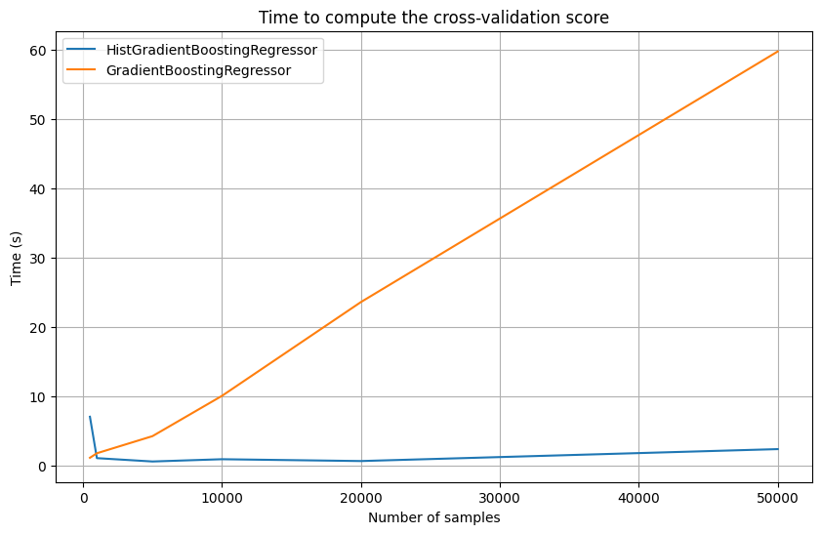
HistGradientBoostingRegressor
For example, using a basic classification dataset with varying sample sizes, we can observe the difference in runtime between a Gradient Boosting Regressor and a Histogram-based Gradient Boosting Regressor. The comparison is conducted using five-fold cross-validation.
As shown, the runtime for the Gradient Boosting model increases linearly with the number of samples. In contrast, the Histogram-based Gradient Boosting model maintains a much lower runtime, even for very large datasets. This efficiency is due to its binning strategy, which reduces the number of split candidates by aggregating continuous feature values into discrete bins. As a result, it achieves faster computation while also conserving memory usage, making it highly suitable for large-scale datasets.

Slide 19
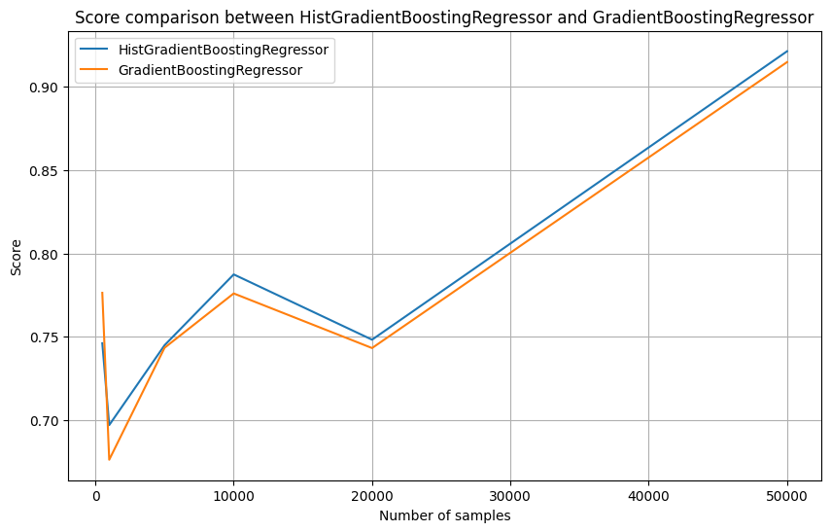
HistGradientBoostingRegressor
Moreover, the average cross-validation scores remain nearly identical for both the Gradient Boosting and Histogram-based Gradient Boosting models, regardless of the sample size. This demonstrates that the Histogram-based Gradient Boosting model maintains comparable predictive performance while significantly improving computational speed and memory efficiency.
In summary, Histogram-based Gradient Boosting provides an excellent balance of strong performance, fast computation, and efficient memory usage, making it a robust choice for large-scale datasets.

Slide 20
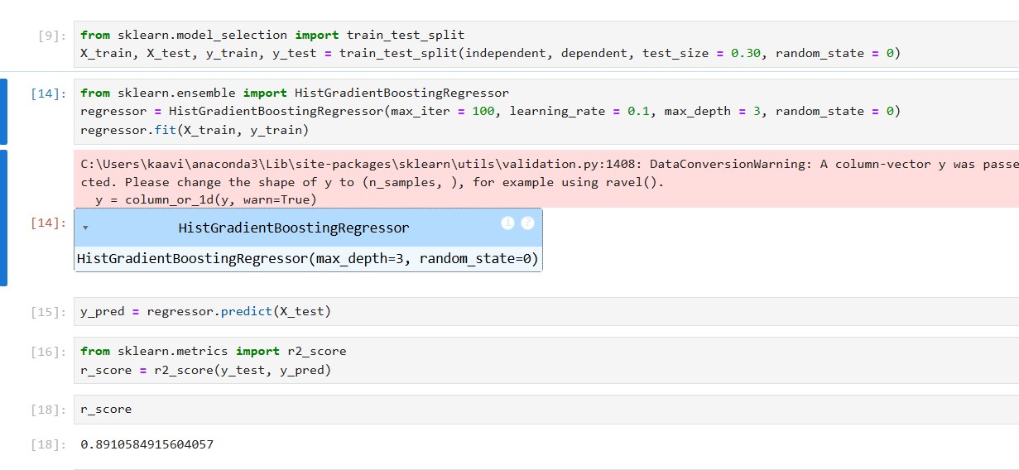
HistGradientBoostingRegressor
Example: HistGradientBoostingRegressor – Insurance Charges Prediction

